Slide 1
Python 3
Business Career Hub

Slide 2
Introduction
Why Machine Learning?
Utilize Big Data
Hardware Improvements
Popular/Common examples
Recommendation Systems
Image Classification
Nature Language Processing
Intuitions
Mapping relationships between Inputs (features) and Outputs (target) of the data
Allow algorithms to find relationships within the data

Slide 3
A Few Definitions
Training/Validation/Test Sets
Training Set
Fed to our model to learn the relationship between the features and the target label
Test Set
Test our model on data is robust and not overfit.

Slide 4
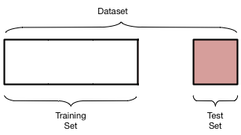

Slide 5
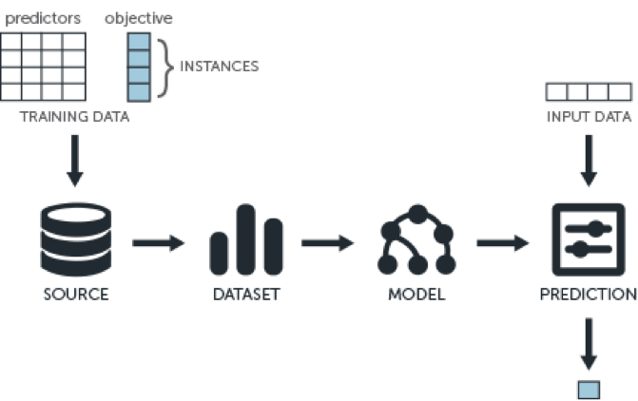
Overview

Slide 6
Classification
Used for classifying data into discrete classes
E.g: Dog Breeds, Plant types, etc.
Goal: Predict the label of a data point from its feature data
Multiple different classification algorithms to choose from for classification purposes
Logistic Regression (Binary Classification)
Linear Discriminant Analysis (LDA)
K - Nearest Neighbors (KNN)
Decision Tree Classifier
Gaussian Naive Bayes
Support Vector Machines (SVM)

Slide 7
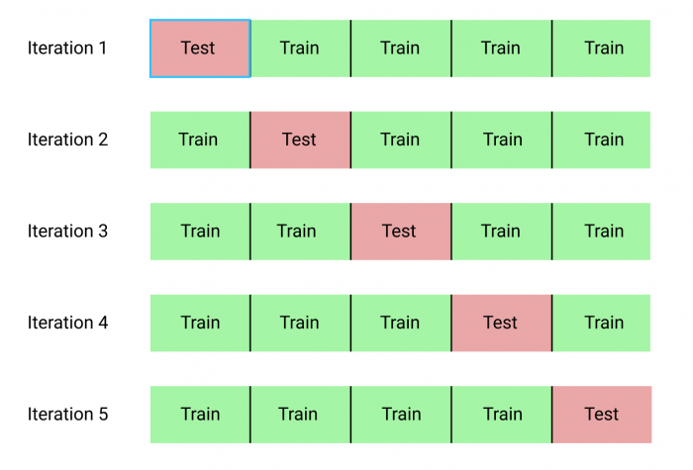
Appendix
K fold validation

Slide 8
Additional Resources
Massive Open Online Courses (MOOC)
Coursera
“Machine Learning” and “Deep Learning” by Andrew Ng of Stanford University
Fast.ai
EDX
CS229 - Stanford U.
Research Papers
Arxiv.org
jmlr.org

